Slide 1
Peptide permability DataSet
Peptide dataset – 400 positive, 6000 negative
5-15 residues long
Converted to various chemical features using Rdkit
It is hoped that chemical features can be easily extended to including staples, which amino acid based features cannot

Slide 2
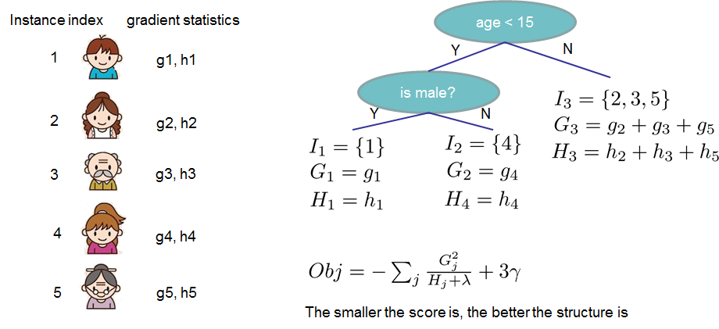
Algorithm Used
Xgboost algorithm
Boosting + tree based algorithm. Boosting is to predict residual errors : (y^{true} - y^{pred}) = tree(X)
For n number of trees:
build tree^{n} that minimizes loss (y^{true –} y^{pred})
update predictions y^{pred} with tree^{n}

Slide 3
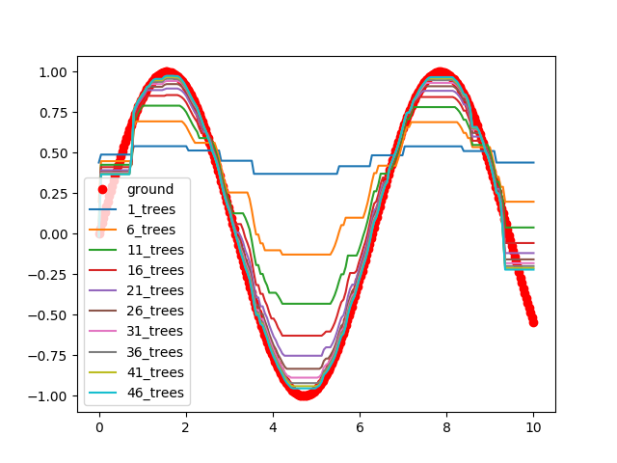
Algorithm explained
A tree based algorithm that fits non-linearities well. Example for fitting cosine curve below

Slide 4
Most important single feature
[(0.6970049933160337, u'SMR_VSA6'),
(0.7000766690257135, u'SlogP_VSA1'),
(0.7014675237870568, u'SMR_VSA4'),
(0.7029370134465676, u'TPSA'),
(0.7037823386018714, u'charge_skew'),
(0.7053845246520406, u'SMR_VSA10'),
(0.7128892427459308, u'SMR_VSA3'),
(0.7161034442085397, u'SMR_VSA2'),
(0.7165113627427852, u'atom_sum_8'),
(0.7238637257214752, u'PEOE_VSA2'),
(0.7294615475347959, u'SlogP_VSA4'),
(0.7364846268774082, u'PEOE_VSA11'),
(0.7417580797357867, u'PEOE_VSA1'),
(0.7449378784304475, u'PEOE_VSA12'),
(0.7877349217582763, u'PEOE_VSA10')]
[(u'SlogP_VSA1', 0.700077),
(u'SMR_VSA4', 0.701468),
(u'TPSA', 0.702937),
(u'PEOE_VSA6', 0.703704),
(u'charge_skew', 0.703782),
(u'SMR_VSA10', 0.705385),
(u'SMR_VSA3', 0.712889),
(u'SMR_VSA2', 0.716103),
(u'atom_sum_8', 0.716511),
(u'PEOE_VSA2', 0.723864),
(u'SlogP_VSA4', 0.729462),
(u'PEOE_VSA11', 0.736485),
(u'PEOE_VSA1', 0.741758),
(u'PEOE_VSA12', 0.744938),
(u'PEOE_VSA10', 0.787735)]
[(u'SMR_VSA9', 0.524603), (u'SlogP_VSA11', 0.524603), (u'HBD_norm', 0.549083), (u'VSA_EState4', 0.568923), (u'atom_sum_16', 0.570909), (u'PEOE_VSA13', 0.571646), (u'charge_kurtosis', 0.601994), (u'PEOE_VSA3', 0.611504), (u'PEOE_VSA14', 0.611838), (u'atom_16', 0.615426), (u'PEOE_VSA4', 0.615524), (u'TPSA_norm', 0.616689), (u'charge_std', 0.622906), (u'VSA_EState5', 0.626804), (u'SlogP_VSA2', 0.638643), (u'VSA_EState9', 0.640609), (u'atom_6', 0.641646), (u'HBA_norm', 0.642624), (u'SlogP_VSA8', 0.644025), (u'atom_len', 0.650935), (u'atom_sum_6', 0.650974), (u'Rotatable_num', 0.651795), (u'SlogP_VSA7', 0.652385), (u'atom_1', 0.654832), (u'LabuteASA_norm', 0.655648), (u'HBD', 0.660479), (u'atom_sum_1', 0.663639), (u'VSA_EState10', 0.665507), (u'atom_7', 0.665664), (u'PEOE_VSA9', 0.665713), (u'PEOE_VSA7', 0.671409), (u'LabuteASA', 0.672397), (u'HBA', 0.673247), (u'atom_size', 0.676078), (u'SMR_VSA7', 0.678658), (u'SlogP_VSA5', 0.680094), (u'SlogP_VSA3', 0.681406), (u'SlogP_VSA6', 0.682782), (u'SMR_VSA1', 0.683224), (u'atom_sum_7', 0.687018), (u'SMR_VSA5', 0.691171), (u'atom_8', 0.69352), (u'PEOE_VSA8', 0.693894), (u'SMR_VSA6', 0.697005), (u'SlogP_VSA1', 0.700077), (u'SMR_VSA4', 0.701468), (u'TPSA', 0.702937), (u'PEOE_VSA6', 0.703704), (u'charge_skew', 0.703782), (u'SMR_VSA10', 0.705385), (u'SMR_VSA3', 0.712889), (u'SMR_VSA2', 0.716103), (u'atom_sum_8', 0.716511), (u'PEOE_VSA2', 0.723864), (u'SlogP_VSA4', 0.729462), (u'PEOE_VSA11', 0.736485), (u'PEOE_VSA1', 0.741758), (u'PEOE_VSA12', 0.744938), (u'PEOE_VSA10', 0.787735)]

Slide 5
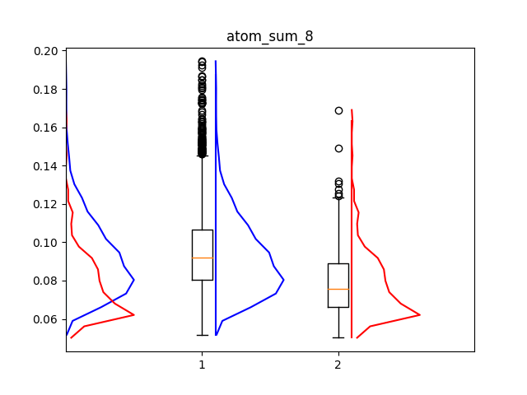
percentage of O

Slide 6
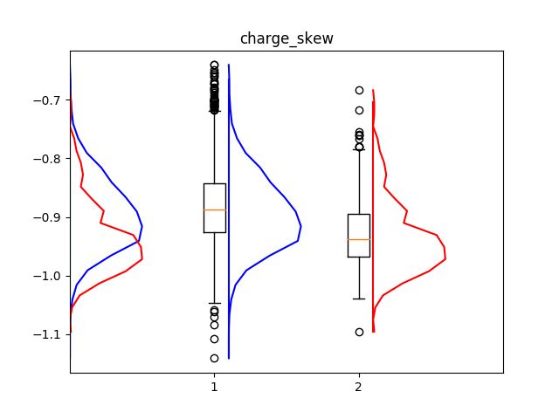
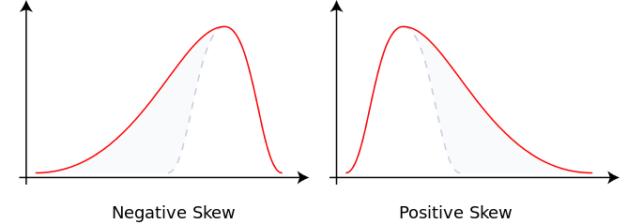
Skew of charges

Slide 7
SlogP_VSA1,4
Surface area with logP within these values
1. -inf < x < -0.40
4. 0.00 <= x < 0.10
['C13d ', 'aromatic heteroatom '],
['C25 ', '4o aromatic '],
['N1 ', '1o amine '],
['N2 ', '2o amine '],
['N3 ', '1o aromatic amine '],
['N4 ', '2o aromatic amine '],
['N8 ', '3o aromatic amine '],
['N10 ', 'protonated amine '],
['N12 ', 'protonated aromatic '],
['NS ', 'nitrogen supplemental '],
['O4 ', 'aromatic ether '],
['O7g ', 'oxide '],
['O12 ', 'acid '],
['Halh ', 'ionic halogens ']
['C7 ', 'acetylene, nitrile '],
['C8 ', '1o aromatic carbon '],
['CS ', 'carbon supplemental '],
['N5 ', 'imine '],
['N9 ', 'nitrile '],
['O5 ', 'oxide ']

Slide 8
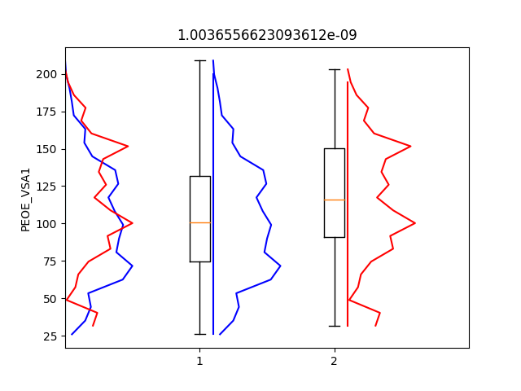
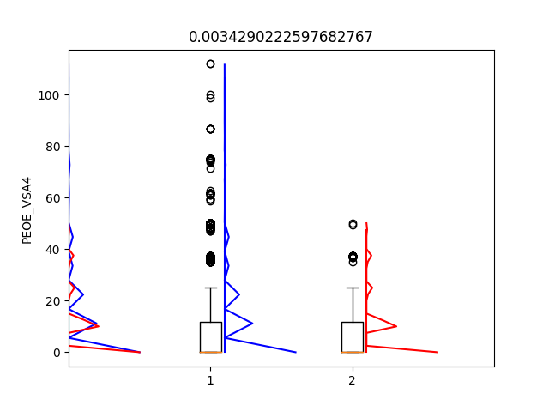
SlogP_VSA1,4
Surface area with logP within these values
['C13d ', 'aromatic heteroatom '],
['C25 ', '4o aromatic '],
['N1 ', '1o amine '],
['N2 ', '2o amine '],
['N3 ', '1o aromatic amine '],
['N4 ', '2o aromatic amine '],
['N8 ', '3o aromatic amine '],
['N10 ', 'protonated amine '],
['N12 ', 'protonated aromatic '],
['NS ', 'nitrogen supplemental '],
['O4 ', 'aromatic ether '],
['O7g ', 'oxide '],
['O12 ', 'acid '],
['Halh ', 'ionic halogens ']
['C7 ', 'acetylene, nitrile '],
['C8 ', '1o aromatic carbon '],
['CS ', 'carbon supplemental '],
['N5 ', 'imine '],
['N9 ', 'nitrile '],
['O5 ', 'oxide ']

Slide 9
PEOP_VSA1,4
Surface area with GasteigerCharges(mol) charge
1. -0.30 <= x < -0.25
2. -0.25 <= x < -0.20
6. -0.05 <= x < -0.00
10. 0.10 <= x < 0.15 *
11. 0.15 <= x < 0.20
12. 0.20 <= x < 0.25
Will get code to see which mol correlates to gastieger charges

Slide 10
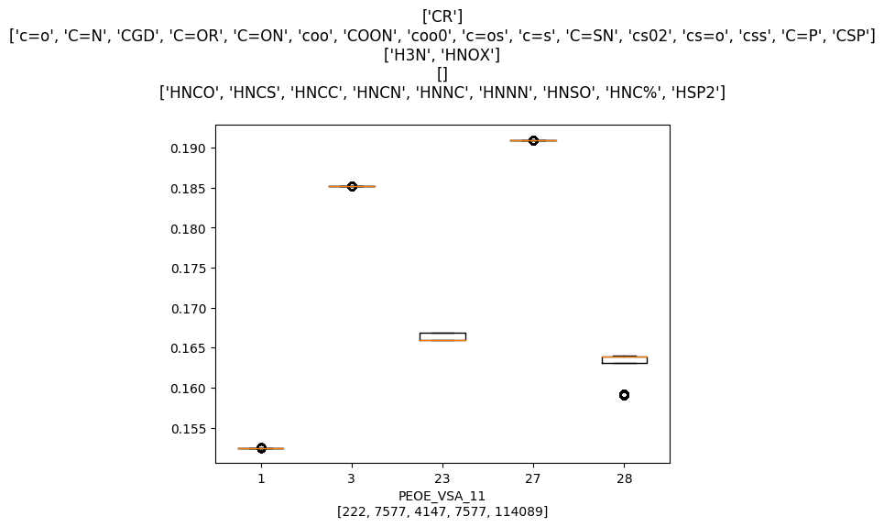
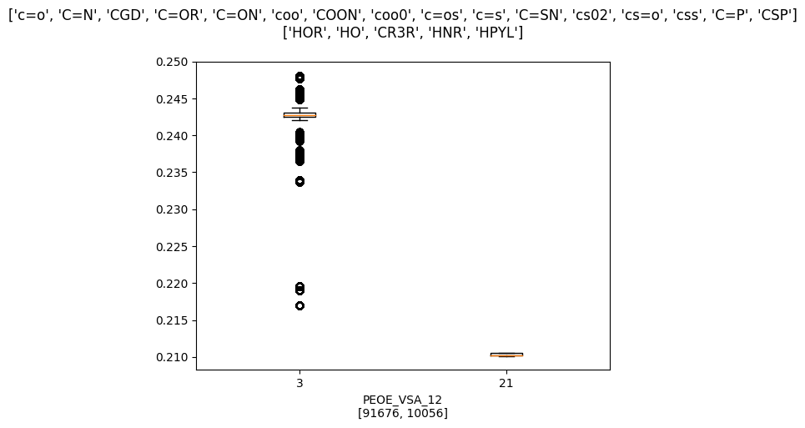
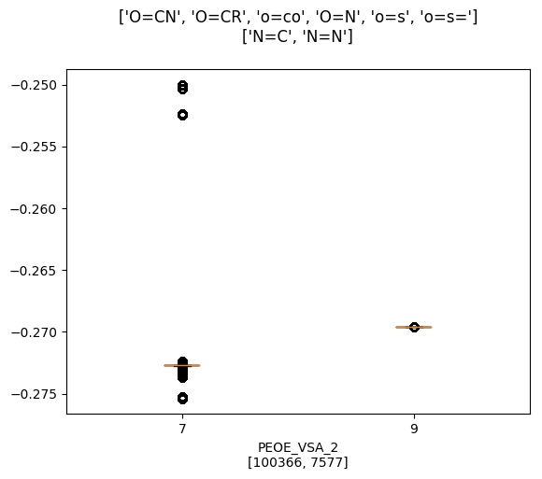
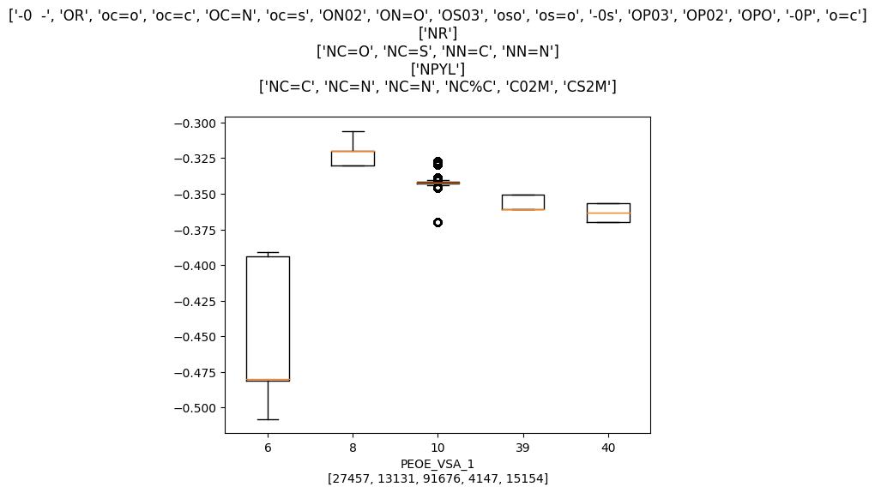
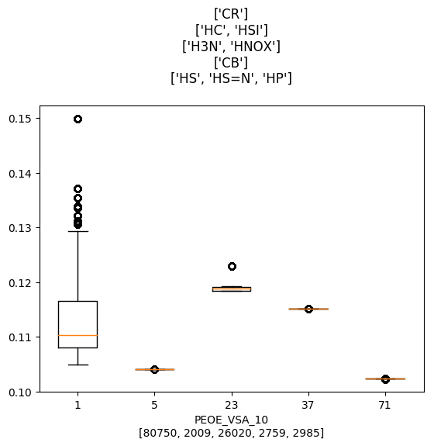
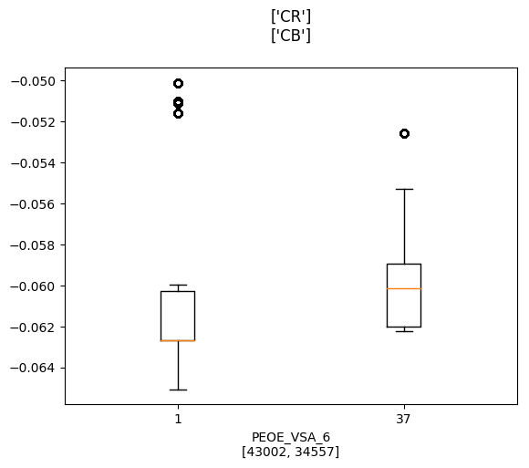

Slide 11
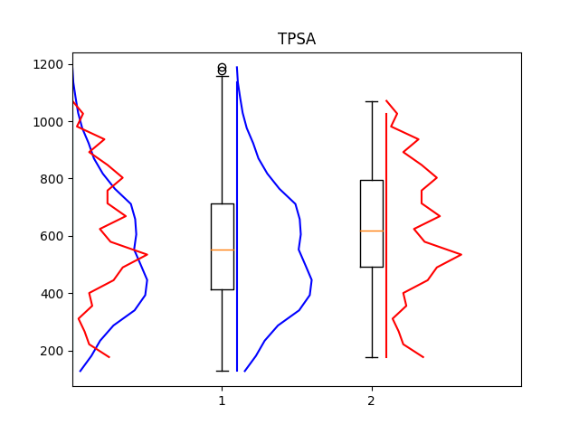
TPSA, polar surface area

Slide 12
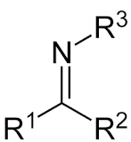
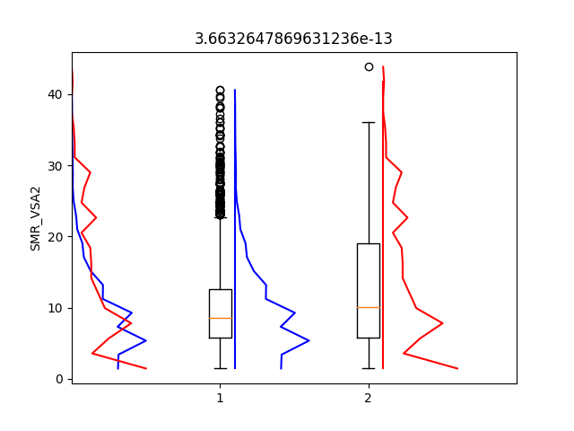
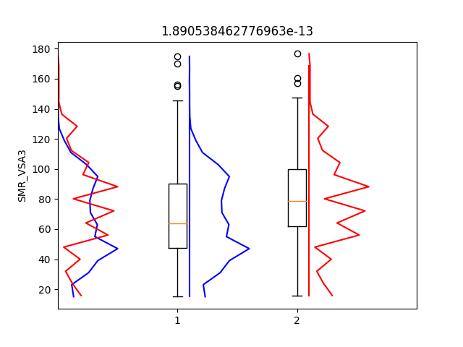
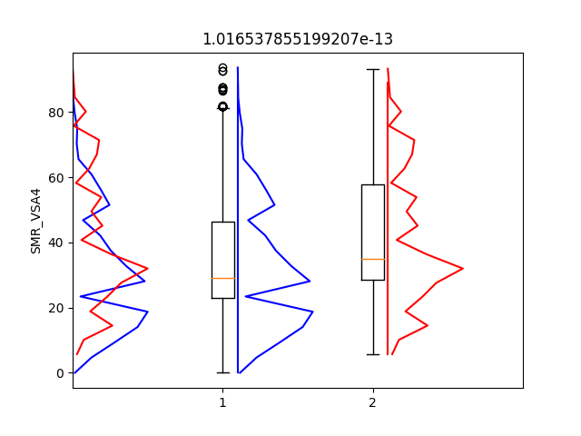
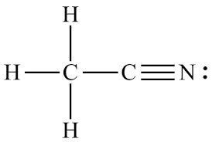
SMR_VSA2,3,4 (97)
['H2f ', 'alcohol '],
['H4 ', 'acid '],
['N5 ', 'imine '],
['N9 ', 'nitrile ']
['N2 ', '2o amine '],
['N7 ', '3o amine '],
['N11 ', 'unprotonated aromatic '],
['NS ', 'nitrogen supplemental ']
['C2 ', '3o, 4o aliphatic '],
['C9 ', '1o aromatic heteroatom '],
['N1 ', '1o amine '],
['N6 ', 'substituted imine ']

Slide 13
Peptide permability DataSets
 | Peptide database | Stapled peptide database
Source | CPP database (+), signal peptide and pdb for (-) | Virdine 2015 paper
Size | 400(+), 6000(-) | 217 peptides, with florescence data
Predictors | Chemical features | Chemical features
Model accuracy | AUC – 93% | Corr ~ 0.65
Peptide dataset – 400 positive, 6000 negative,
5-15 residues long
Converted to various chemical features using Rdkit
It is hoped that chemical features can be easily extended to including staples, which amino acid based features cannot

Slide 14
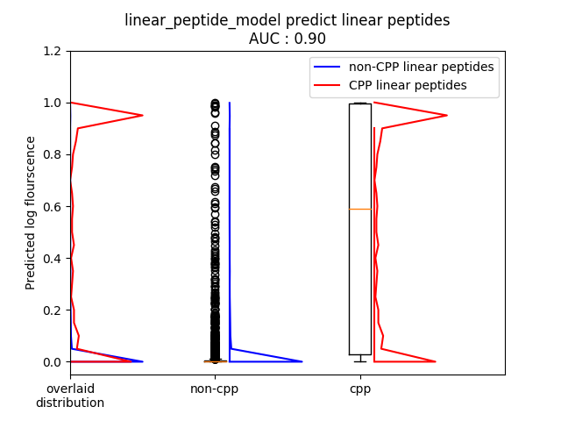
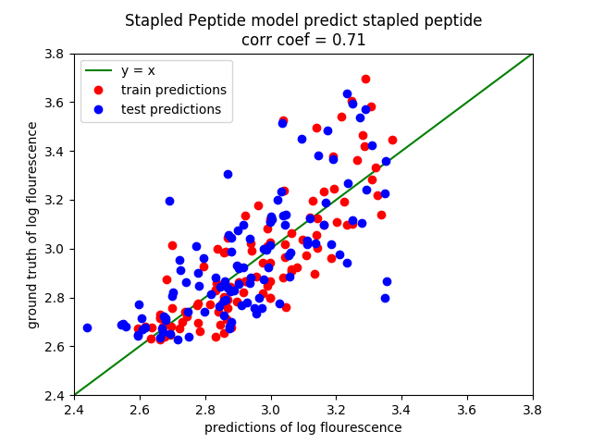
Seems to predict well (50% train, 50% test)
Left (predictions on normal peptide 90% auc)
Right (prediction on stapled peptide R² of 0.35)

Slide 15
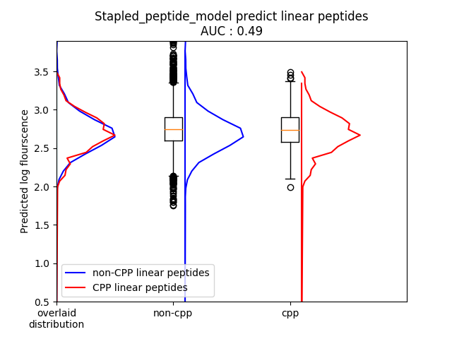
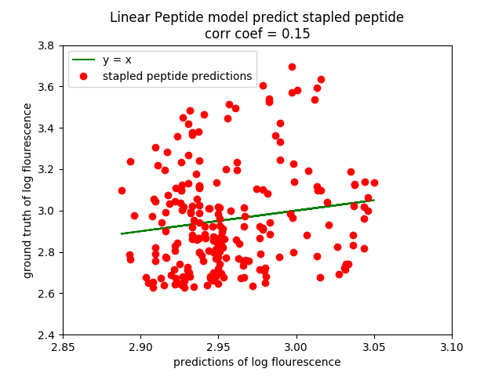
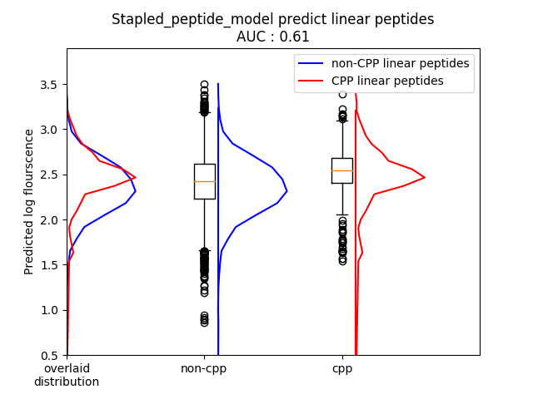
Using stapled peptide model for linear peptide and vice versa
Left (predictions on normal peptide 62% auc)
Right (prediction on stapled peptide R² of 0.02)

Slide 16
Bootstrap Statistics to account for noise
Take half the data as test set.
Perform bootstrapping on train set and get the result
 | Peptide dataset | Stapled peptide
Model (peptide dataset) | 90 AUC | 61 AUC
Model (stapled peptide dataset) | 0.71 | 0.15
Boostrapped | Peptide dataset | Stapled peptide
Model (peptide dataset) | 89 ± 1 AUC | 61 ± 1 AUC
Model (stapled peptide dataset) | 0.65 ± 0.05 | 0.14 ± 0.04

Slide 17
Most import predictors of log fluorescence for stapled peptides
VSA_EState5 0.17 [-0.08, -0.04, -0.0]
PEOE_VSA13_norm 0.17 [0.0, 0.04, 0.08]
charge_skew 0.19 [0.0, 0.05, 0.09]
PEOE_VSA8_norm 0.19 [-0.09, -0.05, -0.01]
atom_1 0.19 [-0.09, -0.05, -0.01]
SlogP_VSA5_norm 0.19 [-0.09, -0.05, -0.01]
TPSA_norm 0.2 [-0.09, -0.05, -0.01]
PEOE_VSA7_norm 0.2 [0.01, 0.05, 0.09]
PEOE_VSA9_norm 0.21 [0.01, 0.05, 0.09]
PEOE_VSA11 0.21 [-0.09, -0.05, -0.01]
atom_6 0.21 [-0.09, -0.05, -0.01]
atom_len 0.21 [-0.09, -0.05, -0.01]
SMR_VSA3 0.21 [-0.09, -0.05, -0.01]
PEOE_VSA14_norm 0.22 [0.01, 0.05, 0.09]
LabuteASA 0.22 [-0.09, -0.05, -0.01]
TPSA 0.22 [-0.09, -0.05, -0.01]
atom_size 0.23 [-0.1, -0.06, -0.01]
PEOE_VSA3_norm 0.23 [0.02, 0.06, 0.1]
VSA_EState8 0.23 [0.02, 0.06, 0.1]
SMR_VSA1 0.24 [-0.1, -0.06, -0.02]
SlogP_VSA10 0.24 [0.02, 0.06, 0.1]
SlogP_VSA5 0.24 [-0.1, -0.06, -0.02]
SlogP_VSA6 0.25 [0.02, 0.06, 0.1]
SMR_VSA5_norm 0.26 [-0.1, -0.06, -0.02]
SMR_VSA5 0.26 [-0.11, -0.06, -0.02]
HBA_norm 0.27 [-0.11, -0.07, -0.03]
SMR_VSA7 0.27 [0.03, 0.07, 0.11]
SlogP_VSA2 0.27 [-0.11, -0.07, -0.03]
PEOE_VSA10_norm 0.27 [-0.11, -0.07, -0.03]
SMR_VSA10 0.28 [-0.11, -0.07, -0.03]
SMR_VSA1_norm 0.28 [-0.11, -0.07, -0.03]
SlogP_VSA10_norm 0.28 [0.03, 0.07, 0.11]
PEOE_VSA8 0.3 [-0.11, -0.07, -0.03]
PEOE_VSA10 0.3 [-0.11, -0.07, -0.03]
atom_sum_8 0.3 [-0.11, -0.07, -0.03]
SlogP_VSA6_norm 0.31 [0.04, 0.08, 0.12]
SlogP_VSA3_norm 0.31 [-0.12, -0.08, -0.04]
SlogP_VSA3 0.31 [-0.12, -0.08, -0.04]
PEOE_VSA12 0.31 [-0.12, -0.08, -0.04]
Rotatable_num 0.31 [-0.12, -0.08, -0.04]
SMR_VSA7_norm 0.32 [0.04, 0.08, 0.12]
SlogP_VSA2_norm 0.32 [-0.12, -0.08, -0.04]
SMR_VSA10_norm 0.34 [-0.12, -0.08, -0.04]
PEOE_VSA1 0.35 [-0.13, -0.09, -0.05]
atom_8 0.35 [-0.13, -0.09, -0.05]
HBA 0.35 [-0.13, -0.09, -0.05]
PEOE_VSA12_norm 0.37 [-0.13, -0.09, -0.05]
PEOE_VSA1_norm 0.37 [-0.13, -0.09, -0.05]
FEATURE, correlation of model, 99% Confidence interval of coefficient
SMR_VSA7 0.27 [0.03, 0.07, 0.11]
SlogP_VSA2 0.27 [-0.11, -0.07, -0.03]
PEOE_VSA10_norm 0.27 [-0.11, -0.07, -0.03]
SMR_VSA10 0.28 [-0.11, -0.07, -0.03]
SMR_VSA1_norm 0.28 [-0.11, -0.07, -0.03]
SlogP_VSA10_norm 0.28 [0.03, 0.07, 0.11]
PEOE_VSA8 0.3 [-0.11, -0.07, -0.03]
PEOE_VSA10 0.3 [-0.11, -0.07, -0.03]
atom_sum_8 0.3 [-0.11, -0.07, -0.03]
SlogP_VSA6_norm 0.31 [0.04, 0.08, 0.12]
SlogP_VSA3_norm 0.31 [-0.12, -0.08, -0.04]
SlogP_VSA3 0.31 [-0.12, -0.08, -0.04]
PEOE_VSA12 0.31 [-0.12, -0.08, -0.04]
Rotatable_num 0.31 [-0.12, -0.08, -0.04]
SMR_VSA7_norm 0.32 [0.04, 0.08, 0.12]
SlogP_VSA2_norm 0.32 [-0.12, -0.08, -0.04]
SMR_VSA10_norm 0.34 [-0.12, -0.08, -0.04]
PEOE_VSA1 0.35 [-0.13, -0.09, -0.05]
atom_8 0.35 [-0.13, -0.09, -0.05]
HBA 0.35 [-0.13, -0.09, -0.05]
PEOE_VSA12_norm 0.37 [-0.13, -0.09, -0.05]
PEOE_VSA1_norm 0.37 [-0.13, -0.09, -0.05]

Slide 18
Less polar surface area
Negative Charges
(lower)
Positive Charges
(higher)
PEOE_VSA
(partial charges)
NEGATIVE SURFACE AREA
PEOE_VSA1_frac 0.36 [-0.129, -0.09, -0.05]
PEOE_VSA1 0.35 [-0.13, -0.09, -0.05]
PEOE_VSA3_norm 0.23 [0.02, 0.06, 0.1]
POSITIVE SURFACE AREA
PEOE_VSA12_norm 0.37 [-0.13, -0.09, -0.05]
PEOE_VSA12 0.31 [-0.12, -0.08, -0.04]
PEOE_VSA10 0.3 [-0.11, -0.07, -0.03]
PEOE_VSA10_norm 0.27 [-0.11, -0.07, -0.03]
PEOE_VSA11 0.21 [-0.09, -0.05, -0.01]
NEUTRAL SURFACE AREA
PEOE_VSA8 0.3 [-0.11, -0.07, -0.03]
PEOE_VSA7_norm 0.2 [0.01, 0.05, 0.09]
PEOE_VSA9_norm 0.21 [0.01, 0.05, 0.09]
PEOE_VSA8 0.27 [-0.107, -0.066, -0.026]

Slide 19
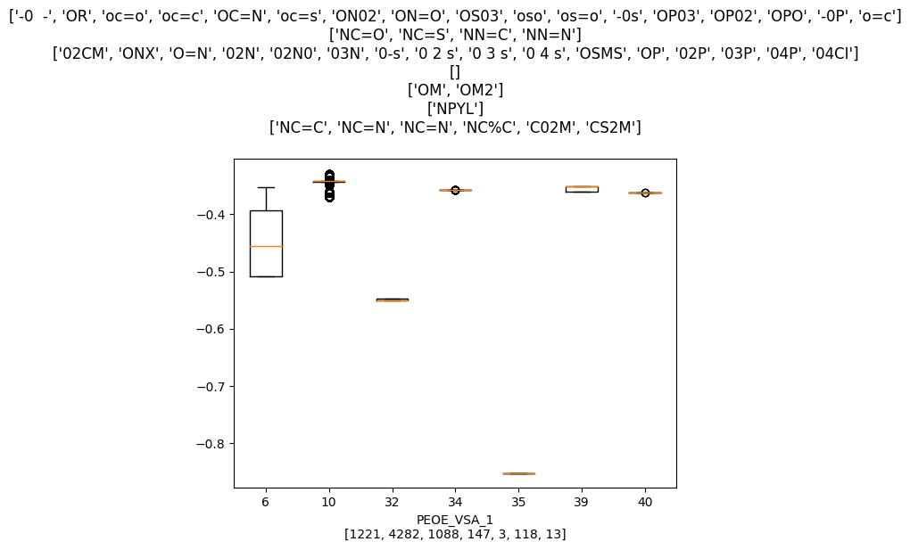
Less double bonded O/N in % and absolute values
PEOE_VSA1_norm 0.37 [-0.13, -0.09, -0.05]
PEOE_VSA1 0.35 [-0.13, -0.09, -0.05]
-

Slide 20
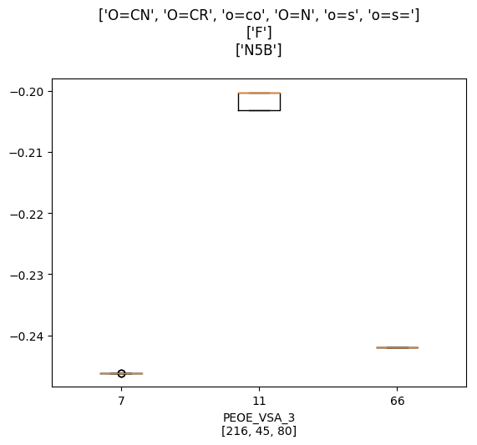
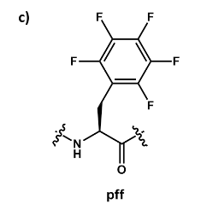
More % aromatic moeities
PEOE_VSA3_frac 0.23 [0.016, 0.058, 0.099]
Carbonyl Oxygen connected to aromatic carbon, aromatic nitrogen
And pff

Slide 21
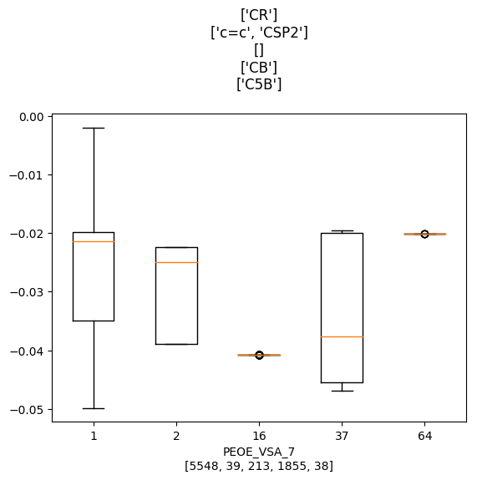
More % hydrocarbon C/aromatic C
PEOE_VSA7_frac 0.3 [0.033, 0.074, 0.114]
atoms neighbours count
1 [1, 1, 1, 5] 517
[1, 1, 5, 5] 3655
[1, 2, 5, 5] 464
[1, 5, 5, 15] 15
[1, 5, 5, 37] 7
[1, 5, 5, 41] 206
[1, 5, 5, 5] 669
[5, 5, 5, 15] 15
16 [3] 213
37 [1, 37, 37] 211
[5, 37, 37] 1606
[5, 37, 63] 51
64 [1, 63, 64] 51
(refer below for key)
Symbolic Numeric Definition [coordination_number] {formal charge}
0 CR 1 Alkyl carbon [4]
1 c=c 2 Vinylic carbon [3]
2 CSP2 2 Generic sp2 carbon [3]
20 HC 5 Hydrogen attached to carbon
21 HSI 5 Hydrogen attached to silicon [I]
56 S 15 Thiol sulfide disulphide sulphur[2]
57 s=c 16 Sulfur doubly bonded to carbon[1]
124 CB 37 Aromatic carbon_benzene [3]
159 C5A 63 Aromatic 5-ring C alpha to N: O: or S: [3]
160 C5B 64 Aromatic 5-ring C beta to N: O: or S: [3]

Slide 22
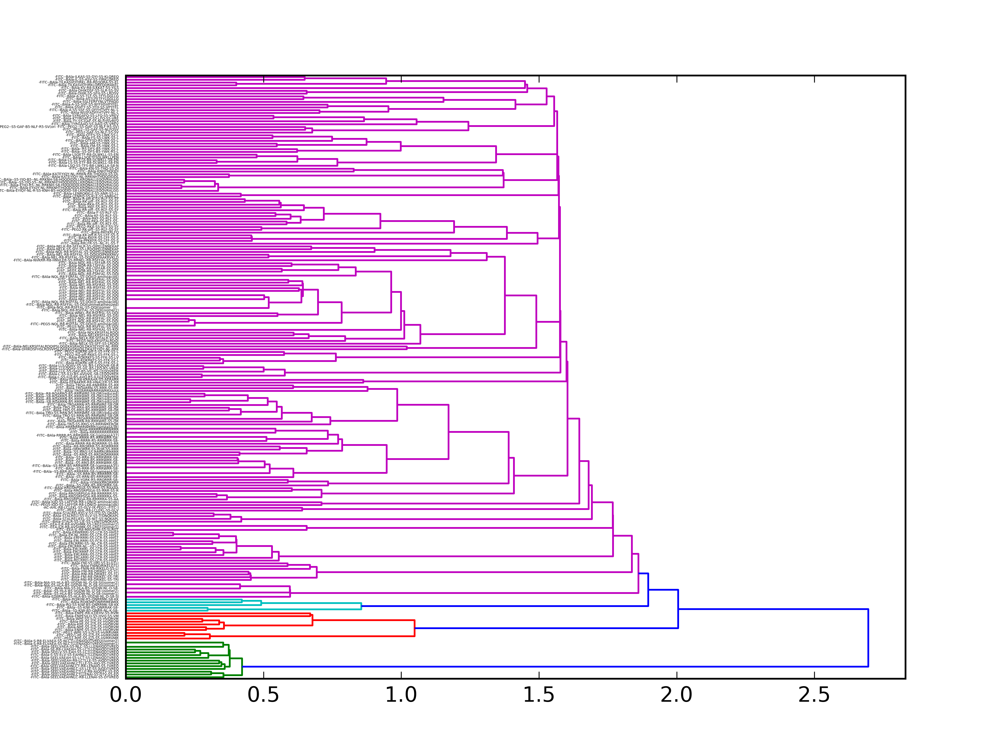
Dealing with non-independent samples
Perform hierarchal clustering based on seq identity. >70% identity as the cluster threshold distance cutoff. ~ 75 clusters
Each cluster given the weight of a single peptide building a weighted linear regression model .
Highly identical sequences just varying staple position
-FITC--BAla-S-S5-ELV-S5-EAHNLCTLLENAIQDTVREQ
-FITC--BAla-SEELV-S5-EAH-S5-LCTLLENAIQDTVREQ
-FITC--BAla-SEELVAEA-S5-NLC-S5-LLENAIQDTVREQ
-FITC--BAla-SEELVAEAH-S5-LCT-S5-LENAIQDTVREQ
-FITC--BAla-SEELVAEAHNLC-S5-LLE-S5-AIQDTVREQ
-FITC--BAla-SEELVAEAHNLCTLLE-S5-AIQ-S5-TVREQ
-FITC--BAla-SEELVAEAHNLCTLLENAI-S5-DTV-S5-EQ
-FITC--BAla-S-R8-ELVAEA-S5-NLCTLLENAIQDTVREQ(isomer1)
-FITC--BAla-S-R8-ELVAEA-S5-NLCTLLENAIQDTVREQ(isomer2)
-FITC--BAla-SE-R8-LVAEAH-S5-LCTLLENAIQDTVREQ
-FITC--BAla-SEELVAEAH-R8-LCTLLE-S5-AIQDTVREQ
-FITC--BAla-SEELVAEAHNLC-R8-LLENAI-S5-DTVREQ
-FITC--BAla-SEELVAEAHNLCT-R8-LENAIQ-S5-TVREQ
-FITC--BAla-SEELVAEAHNLCTLLE-R8-AIQDTV-S5-EQ

Slide 23
Building Features
Features considered
1. Num, Norm, NormSA of each amino acid
2. 1,2,3,4 Moment of Gasteiger Charge distributions
3. Polar, nonpolar surface area
4. Number and % of HBA,HBD
5. Length, molecular weight

Slide 24
Finding Import features
Univariate Linear Regression for each variable
Obtain features which have correlation coefficients at significant threshold (5%).
Total degrees of freedom of model = 75-2=73

Slide 25
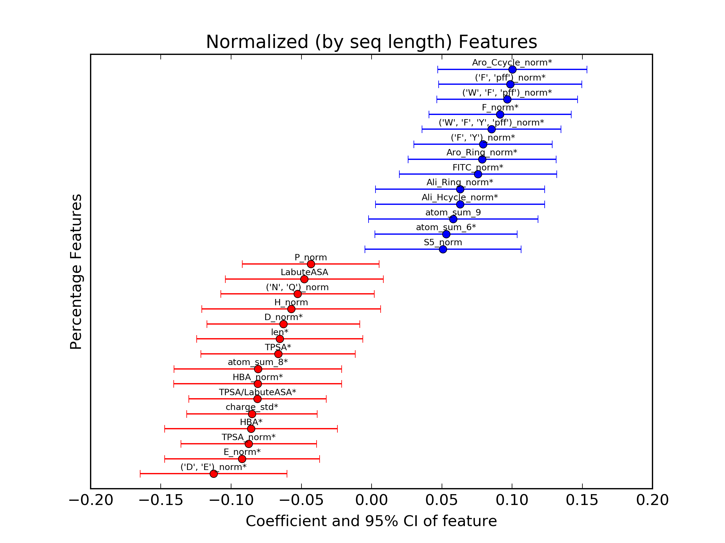
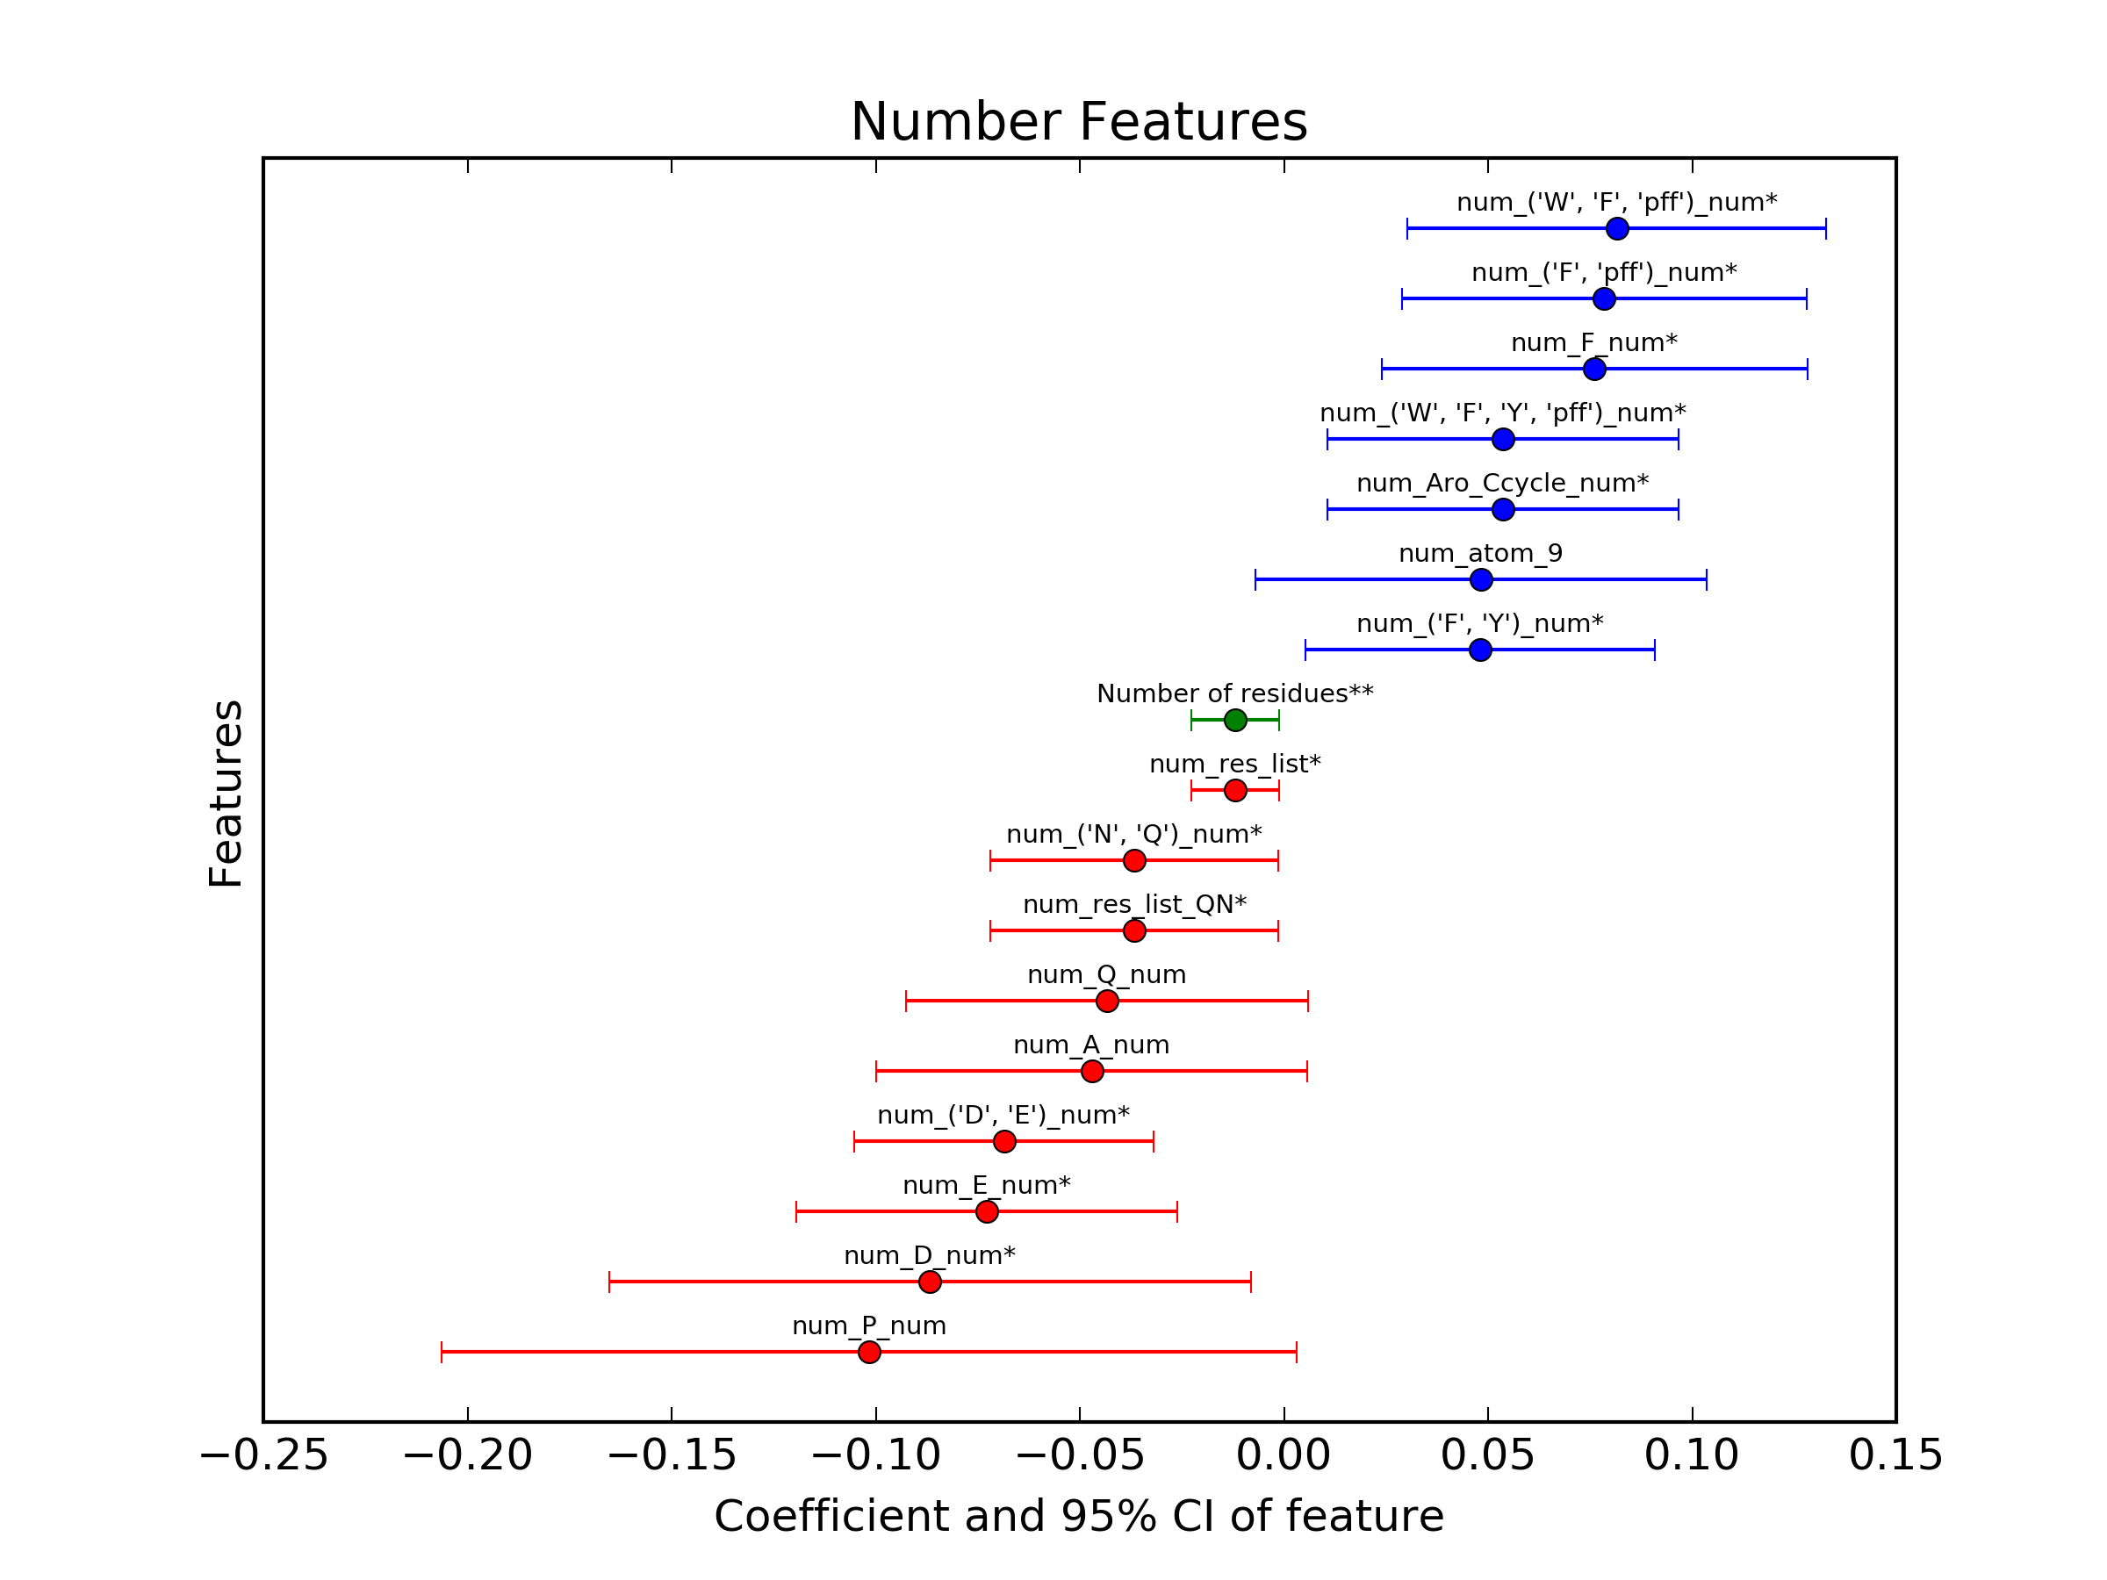
Features with coefficient !=0.
*,**,*** - sig of 0.1, 0.05, 0.02
'F', 'Y')_normSA 0.0705 0.105
('F', 'Y')_norm 0.0793 0.124
('F', 'Y')_num 0.0479 0.064
('F', 'pff')_normSA 0.0949 0.161
('F', 'pff')_norm 0.0987 0.170
('F', 'pff')_num 0.0784 0.120
('W', 'F', 'Y', 'pff')_normSA 0.0778 0.121
('W', 'F', 'Y', 'pff')_norm 0.0853 0.140
('W', 'F', 'Y', 'pff')_num 0.0536 0.078
('W', 'F', 'pff')_normSA 0.0905 0.153
('W', 'F', 'pff')_norm 0.0965 0.169
('W', 'F', 'pff')_num 0.0815 0.121
FITC_normSA 0.0583 0.059
FITC_norm 0.0757 0.091
F_normSA 0.0855 0.138
F_norm 0.0914 0.151
F_num 0.0761 0.104
norm_Ali_Hcycle 0.0630 0.056
norm_Ali_Ring 0.0630 0.056
norm_Aro_Ccycle 0.1001 0.163
norm_Aro_Ring 0.0787 0.109
num_Aro_Ccycle 0.0536 0.078
num_Aro_Ring 0.0314 0.031
Coefficients are not
comparable between
plots
Higher charged residues correlated to poorer permability

Slide 26
Num, Norm, NormSA
Num – number of particular amino acid
L^{num} = Number^{L}
Number of particular AA
Norm – percentage of particular amino acid over sequence length
L^{norm} = Number^{L}/Total_length
Normalized length
NormSA – percentage of SA of particular acid
L^{normSA} = SurfaceArea^{L}/Total_SA
Overal Chemical Property

Slide 27
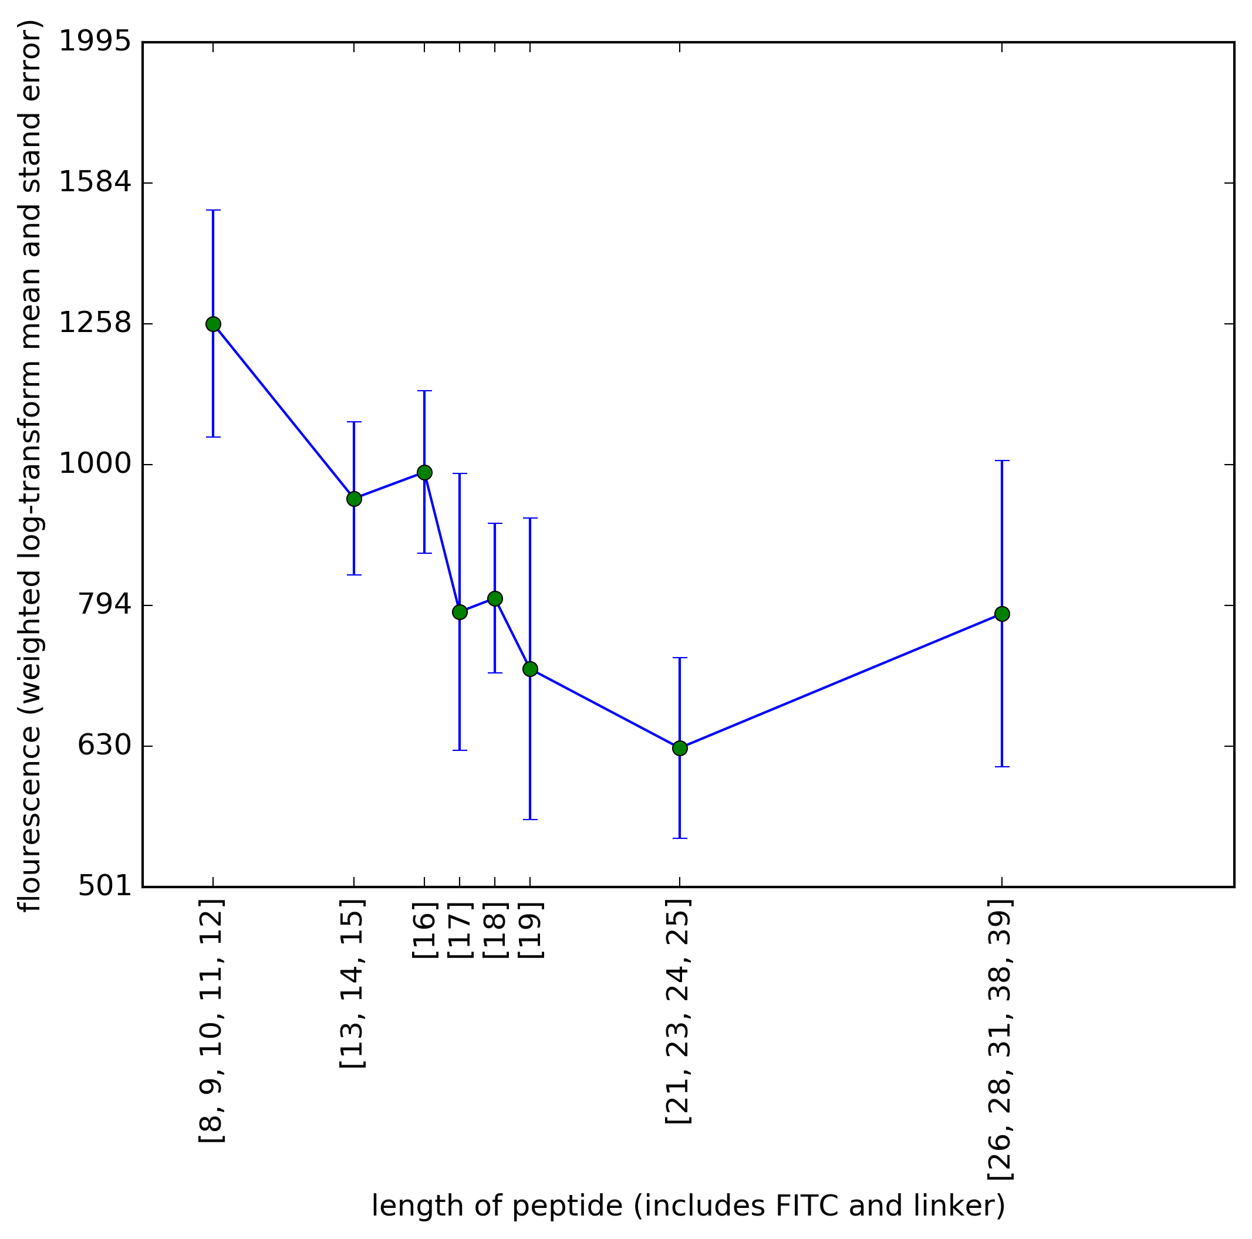
Length

Slide 28
Overall molecular Features
Stapled peptides have higher florescence than linear peptides
Low polarity
charge_std -0.083 0.1469
TPSA_norm -0.087 0.1491
charge_kurtosis 0.0377 0.026 (fatter distribution has + kurtosis)
Smaller size
Length -0.011 0.0617
Rotatable_num_ -0.002 0.0704
1/length 0.0734 0.088
Less HBA
More aromatic Rings, specifically phe

Slide 29
Residue level feature
 | (-) | (+)
Features | ('D', 'E')_num_ -0.068 0.1596 ('D', 'E')_norm_ -0.112 0.2019 ('D', 'E')_normSA_ -0.117 0.2021 E_num_ -0.072 0.1177 E_norm_ -0.092 0.1338 E_normSA_ -0.097 0.1360 D_num_ -0.085 0.0614 D_norm_ -0.062 0.0667 D_normSA_ -0.064 0.0703
 | ('N', 'Q')_num_ -0.06 0.0626 ('N', 'Q')_norm_ -0.05 0.0564 Q_num_ -0.06 0.0518 Q_norm_ -0.04 0.0403 N_num_ -0.03 0.0228 N_norm_ -0.03 0.0234
 | H_num_ -0.05 0.0502 H_norm_ -0.05 0.0516 R_num_ -0.015 0.0042 K_num_ -0.011 0.0026
 | P_num_ -0.04 0.0568 P_norm_ -0.04 0.0442
 | A_num_ -0.04 0.0355 I_num_ -0.03 0.0260 A_norm_ -0.022 0.0118 I_norm_ -0.025 0.0123 G_num_ -0.025 0.0127 G_norm_ -0.011 0.0029
 | T_num_ -0.030 0.0125 T_norm_ -0.018 0.0063
 | Y_num_ -0.012 0.0041
 | Negative correlated with log florescence | Positive correlated with log florescence
Staple |  | S5_norm_0.084 S5_num_0.055 S8_norm_0.045 S8_num_0.045 B5_norm_0.053 B5_num_0.053
aromatic features |  | F_norm_0.061 F_num_0.043
Acidic | D_norm_-0.084 D_num_-0.089 E_norm_-0.059 E_num_-0.062
Polar non charged | N_num_-0.065 N_norm_-0.056 Q_norm_-0.043 Q_num_-0.055
Helix breakers | P_norm_-0.054 P_num_-0.058 G_norm_-0.036 G_num_-0.048
 | V_num_-0.061 V_norm_-0.059 I_num_-0.056 A_norm_-0.051 L_num_-0.044 I_norm_-0.042
Size of molecule |  | FITC_norm_0.074 BAla_norm_0.043
 | HBA_norm_-0.082 TPSA_norm_-0.099 charge_std_-0.100 atom_sum_8 -0.08 HBA -0.07
 | Rotatable_num_-0.069 res_list_ -0.011 0.0617
Low percentage of acidic amino acids
('D', 'E')_num -0.068 0.1603
('D', 'E')_normSA -0.117 0.2016
('D', 'E')_norm -0.112 0.2021
Less Charged AA
('N', 'Q')_num -0.036 0.0557
('N', 'Q')_normSA -0.058 0.0575
H_norm -0.057 0.0423
(R and K was found to be weakly (+) and (-) correlated with florescence
Hydrophobic groups (PHE) highly correlated with flourscence

Slide 30
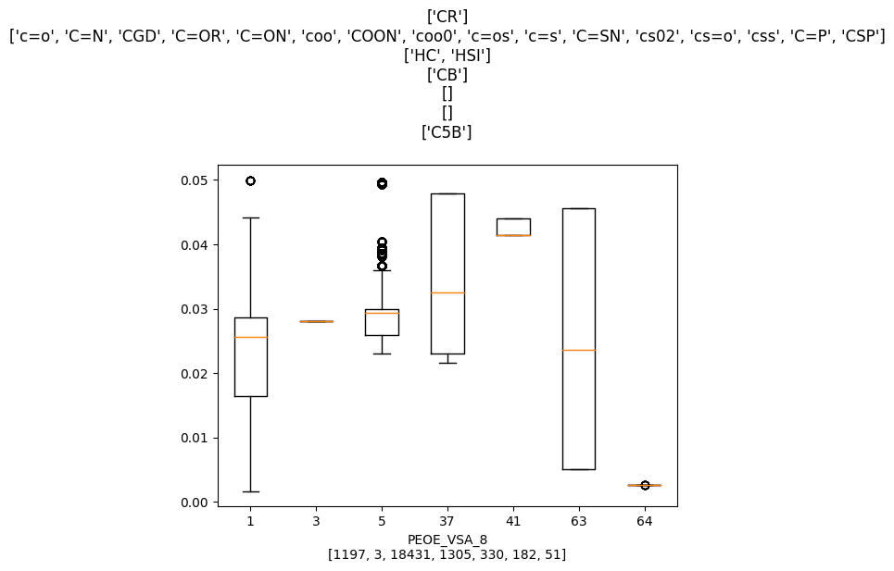
Less hydrocarbon C/aromatic C
PEOE_VSA8_norm 0.19 [-0.09, -0.05, -0.01]
PEOE_VSA8 0.3 [-0.11, -0.07, -0.03]
atoms neighbours number
1 [1, 3, 5, 5] 450
[1, 5, 5, 10] 251
[1, 5, 5, 15] 27
[1, 5, 5, 37] 213
[1, 5, 5, 41] 124
[1, 5, 5, 64] 131
5 [1] 18431
37 [1, 37, 37] 657
[10, 37, 37] 216
[5, 37, 37] 432
41 [1, 32, 32] 330
63 [37, 39, 64] 51
[5, 39, 64] 131
64 [37, 63, 64] 51
Symbolic Numeric Definition [coordination_number] {formal charge}
0 CR 1 Alkyl carbon [4]
20 HC 5 Hydrogen attached to carbon
21 HSI 5 Hydrogen attached to silicon [I]
124 CB 37 Aromatic carbon_benzene [3]
159 C5A 63 Aromatic 5-ring C alpha to N: O: or S: [3]
160 C5B 64 Aromatic 5-ring C beta to N: O: or S: [3]

Slide 31
Difference between PEOE_VSA7 and PEOE_VSA8

Slide 33
What do these virtual surface area (VSA) features mean
Negative Charge
(lower)
Positive Charge
(higher)
PEOE_VSA
(partial charges)
Less lipophilic
(lower)
More Lipophilic
(higher)
SlogP_VSA
(lipophilicity)
Lower MR
(lower)
High MR
(higher)
SMR_VSA
(Molecular reflectivity?)
Features include absolute values and fractional values (over the entire molecule)

Slide 34
General Findings
More Hydrophobic
- SlogP_VSA2_frac reg coefficient -0.093**
- PEOE_VSA7_frac reg coefficient : 0.074
Less Polar
- PEOE_VSA1_frac, PEOE_VSA12_frac, PEOE_VSA1 reg coefficient : 0.09**
Smaller molecule
-Rotatablebond Num reg coeff : -0.89
-smaller atom size reg coeff : -0.055
** pval 1% significance

Slide 35
General Findings
More Hydrophobic
- SlogP_VSA2_frac reg coefficient -0.093**
- PEOE_VSA7_frac reg coefficient : 0.074
Less Polar
- PEOE_VSA1_frac, PEOE_VSA12_frac, PEOE_VSA1 reg coefficient : 0.09**
Smaller molecule
-Rotatablebond Num reg coeff : -0.89
** pval 1% significance

